Slide 1


UNIT 1; All about me
Secrets of success

Slide 2
Do you always wake up at the same time in the morning?
When do you wake up?
Do you have enough time for all your planned activities in a day?
Do you always listen carefully during lessons?
Do you do your homework regularly?
How do you relax?

Slide 3
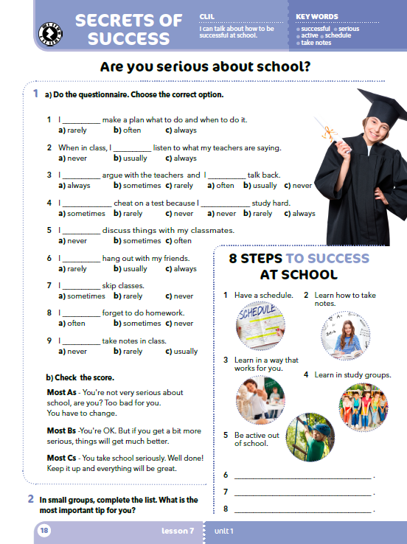
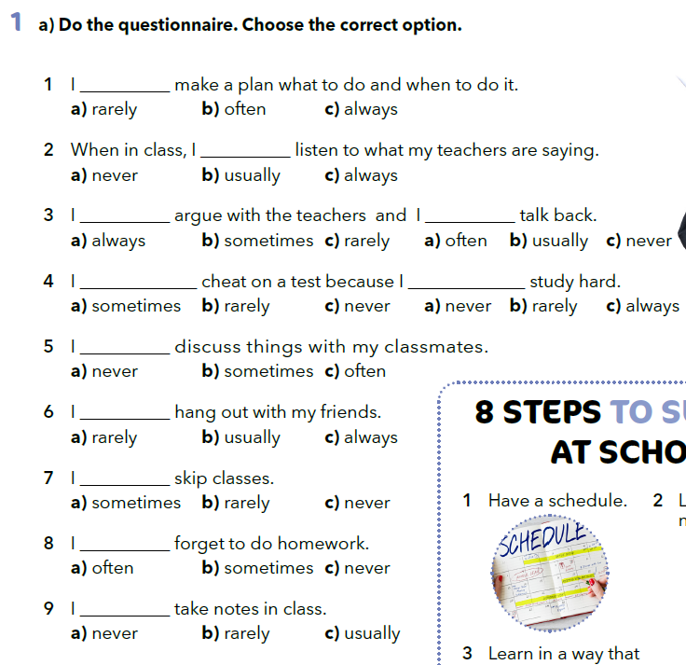
Do the questionnaire. Choose the correct option.

Slide 4
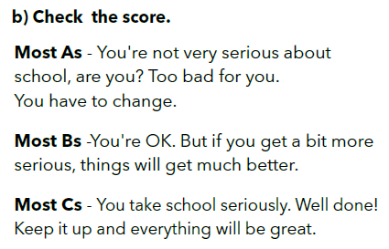

Slide 5
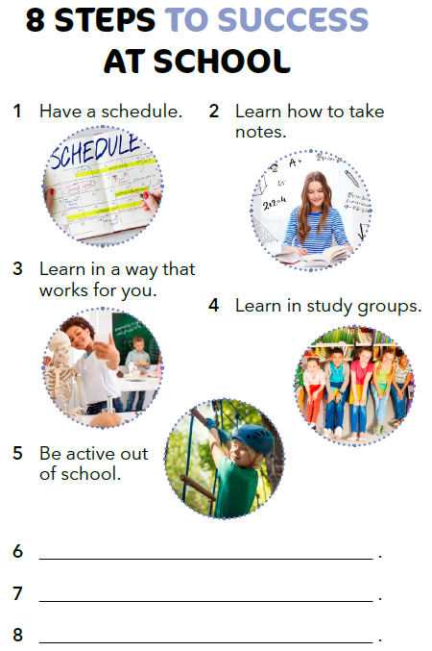
Always make a plan what to do and when to do it.
When in class, always listen to what your teachers are saying.
Complete the list of steps to success in school.
Dos and DON’Ts
https://wordwall.net/play/538/770/525

Slide 6

LEARN MORE!
https://www.e-sfera.hr/dodatni-digitalni-sadrzaji/23ea628d-37dc-4830-9284-3d903d665197/
Strange habits of 10 famous people
.

